Slide 1



A PROJECT PRESENTATION on
Design and Implementation of a
Scalable Telecom Customer Churn
Prediction and Retention Platform
using PySpark and Machine Learning
MCA SEM IV · Batch 2024–26
PRESENTED BY
Divyesh S. Joshi
Seat No.: 52419 | Roll No.: MC24097
UNDER THE GUIDANCE OF
Prof. Yugandhara Patil
IIMS Chinchwad, Pune · Savitribai Phule Pune University
Design and Implementation of a Scalable Telecom Customer Churn Prediction and Retention Platform
Design and Implementation of a Scalable Telecom Customer Churn Prediction and Retention Platform
Notes:
1

Slide 2
Content
01
Introduction & Company Profile
07
ER Diagram & Database Design
02
Problem Statement & Objectives
08
Screenshots & Reports
03
Scope of Project
09
Test Cases & Results
04
Technology Used
10
Limitations & Future Enhancements
05
System Analysis — Functional & Non-Functional Requirements
11
Conclusion
06
UML Diagrams
12
References & Annexure (Sample Code)
Design and Implementation of a Scalable Telecom Customer Churn Prediction and Retention Platform
Notes:
2

Slide 3
01
INTRODUCTION
Company Profile · Problem Statement · Objectives
Design and Implementation of a Scalable Telecom Customer Churn Prediction and Retention Platform
Notes:
3

Slide 4
Introduction
What is Customer Churn?
Customer churn occurs when subscribers discontinue a telecom service and switch to competitors — representing direct, measurable revenue loss.
The Business Problem
The IBM Telco dataset reveals a 26.5% churn rate. Manual identification of at-risk customers is slow, subjective, and does not scale to enterprise volumes.
Company: D-Table Analytics
A technology and analytics company providing data engineering, BI, and automation solutions. This project was developed as part of OJT requirements for MCA Sem IV.
7,043
26.5%
Total Customers
Churn Rate
3
48
ML Models Trained
Unit Tests — 100% Pass
Design and Implementation of a Scalable Telecom Customer Churn Prediction and Retention Platform
Notes:
4

Slide 5
Objectives of the Proposed System
01
02
03
Design and implement complete ETL pipeline using Python, Pandas, and PySpark
Clean, transform, and engineer features from IBM Telco dataset (7,043 records, 21 columns)
Train 3 ML models (RF, GBT, LR); auto-select best by ROC-AUC score
04
05
06
Score all customers with ChurnProbability and 3-tier ChurnRisk classification
Generate personalised retention offers via a 7-strategy recommendation engine
Develop 5-page role-based Streamlit analytics dashboard
07
08
09
Implement PBKDF2-SHA256 authentication with session management and audit logging
Demonstrate scalable distributed processing using Apache PySpark 3.5
Achieve 100% unit test pass rate across all modules (48 tests, 9 classes)
Design and Implementation of a Scalable Telecom Customer Churn Prediction and Retention Platform
Notes:
5

Slide 6
Scope of the Proposed System
ETL
End-to-End ETL Pipeline CSV extraction → data cleaning → feature engineering → PostgreSQL loading
ML
Machine Learning Pipeline 3 classification models trained; best auto-selected by ROC-AUC; batch customer scoring
AI
Retention Offer Engine 7-strategy personalised recommendation engine mapped to customer risk profiles
UI
Streamlit Dashboard 5-page interactive dashboard: Executive, Churn Predictor, At-Risk, Model Performance, Admin
🔐
Authentication System PBKDF2-SHA256 hashing, session management, complete access logging to CSV
⚡
PySpark Integration Enterprise-scale distributed processing supporting 1M+ records in cluster mode
✅
Comprehensive Test Suite 48 unit tests across 9 test classes — 100% pass rate achieved
Design and Implementation of a Scalable Telecom Customer Churn Prediction and Retention Platform
Notes:
6

Slide 7
Technology Used
Component | Technology / Framework | Version
Frontend / Dashboard | Streamlit (Python-based web UI framework) | 1.35+
Visualisation | Plotly Express and Plotly Graph Objects | 5.20+
Backend Language | Python | 3.11+
Data Processing | Pandas, NumPy | 2.0+
Big Data Processing | Apache PySpark (local and cluster mode) | 3.5
Machine Learning | scikit-learn, XGBoost | 1.4 / 2.0
Database | PostgreSQL via SQLAlchemy | 15 / 2.0
Authentication | PBKDF2-SHA256 (Python hashlib), st.session_state | —
Testing | pytest, pytest-cov | 8.0+
Version Control | Git and GitHub | —
Dataset | IBM Telco Customer Churn — Kaggle (7,043 records) | —
Design and Implementation of a Scalable Telecom Customer Churn Prediction and Retention Platform
Notes:
7

Slide 8
Functional Requirements
FR ID | Module | Requirement Description
FR-01 | ETL | Extract data from IBM Telco CSV; validate all 21 required columns
FR-02 | ETL | Clean data: fix TotalCharges type, impute median, remove duplicates
FR-03 | ETL | Engineer features: tenure_group, RevenueCategory, AnnualRevenue, LoyaltyScore
FR-04 | ETL | Load cleaned and scored data to PostgreSQL in two tables
FR-05 | ML | Train 3 ML models; auto-select best by ROC-AUC score
FR-06 | ML | Score all customers with ChurnProbability and ChurnRisk (High/Medium/Low)
FR-07 | Recommend | Generate personalised retention offers for at-risk customers
FR-08 | Dashboard | Display KPIs, charts, and at-risk lists across 5 Streamlit pages
FR-09 | Auth | Authenticate users with PBKDF2-SHA256 hashed passwords
FR-10 | Admin | Admin: add/delete users, change passwords, view complete access log
Design and Implementation of a Scalable Telecom Customer Churn Prediction and Retention Platform
Notes:
8

Slide 9
UML Diagrams
Use Case
Class Diagram
Module Hierarchy
Actors: User (login, dashboard, predictor, export) and Admin (all user actions + ETL execution, user management, access log)
8 core classes: DataExtractor, DataTransformer, DataLoader, ModelTrainer, ChurnPredictor, OfferEngine, AuthManager, SparkETL
4 top-level subsystems: ETL Layer, ML Layer, App Layer, Auth Layer — each decomposed to individual functions and methods
Sequence Diagram
Component Diagram
Activity Diagram
Login sequence (PBKDF2 verify → log) and Prediction sequence (predict_proba() → offer card → gauge chart → dashboard)
3 layers: processing (CSV→extract→transform→train), logic (load→predict→recommend→auth→app), storage (DB / model / log files)
ETL flow: CSV extract → validate → backup → clean → feature engineering → ML training → scoring → offers → PostgreSQL load
Design and Implementation of a Scalable Telecom Customer Churn Prediction and Retention Platform
Notes:
9

Slide 10
ER Diagram & Database Design
PostgreSQL analytical store: two tables + users.json credentials + logs/access_log.csv
customer_churn_raw
customer_churn_cleaned (key columns)
Column | Type | Constraint | Description
customerID | VARCHAR(50) | PK | Unique 7-char ID
gender | VARCHAR(10) | NULL | Male or Female
SeniorCitizen | SMALLINT | NULL | 0 = No, 1 = Yes
tenure | INT | NULL | Months with company
MonthlyCharges | FLOAT | NULL | Monthly billing $
TotalCharges | FLOAT | NULL | Cumulative charges
Contract | VARCHAR(50) | NULL | Contract type
Churn | VARCHAR(10) | NULL | Yes / No (raw)
Column | Type | Description
customerID | VARCHAR(50) | PRIMARY KEY — unique ID
Churn | SMALLINT | 1 = Churned, 0 = Retained
tenure_group | VARCHAR(20) | 0-1yr, 1-2yr, 2-4yr, 4-6yr
RevenueCategory | VARCHAR(10) | Low / Medium / High
AnnualRevenue | FLOAT | MonthlyCharges × 12
LoyaltyScore | FLOAT | Normalised tenure 0.0–1.0
ChurnProbability | FLOAT | ML predicted probability
ChurnRisk | VARCHAR(10) | Low / Medium / High tier
OfferTitle | VARCHAR(100) | Recommended retention offer
Design and Implementation of a Scalable Telecom Customer Churn Prediction and Retention Platform
Notes:
10

Slide 11
Data Dictionary — Key Fields
Field Name | Type | Range / Values | Description
customerID | String | Unique | 7-character alphanumeric ID assigned to each customer
tenure | Integer | 0 – 72 | Number of months the customer has been with the company
MonthlyCharges | Float | 18.25 – 118.75 | Amount charged to the customer monthly in USD
TotalCharges | Float | 18.85 – 8684.8 | Total amount charged; blank entries imputed with median
Churn | Binary Int | 0 or 1 | Target variable: 1 = churned, 0 = retained
ChurnProbability | Float | 0.0 – 1.0 | ML-predicted probability of churn for each customer
ChurnRisk | String | Low/Med/High | Low < 35%, Medium 35–65%, High > 65%
LoyaltyScore | Float | 0.0 – 1.0 | Normalised tenure: tenure divided by maximum tenure
AnnualRevenue | Float | 219 – 1425 | Projected annual revenue: MonthlyCharges × 12
RevenueCategory | String | Low/Med/High | Low < ₹35, Medium ₹35–70, High > ₹70 monthly
OfferTitle | String | 7 offer types | Recommended retention offer for each at-risk customer
Design and Implementation of a Scalable Telecom Customer Churn Prediction and Retention Platform
Notes:
11

Slide 12
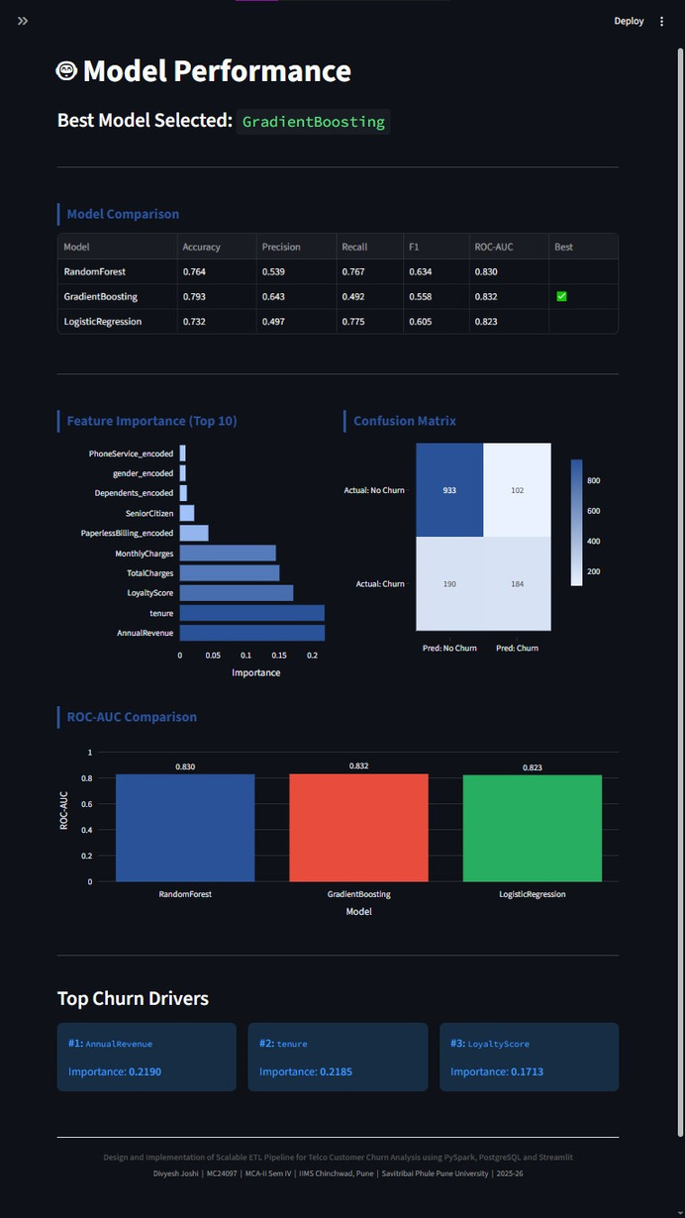
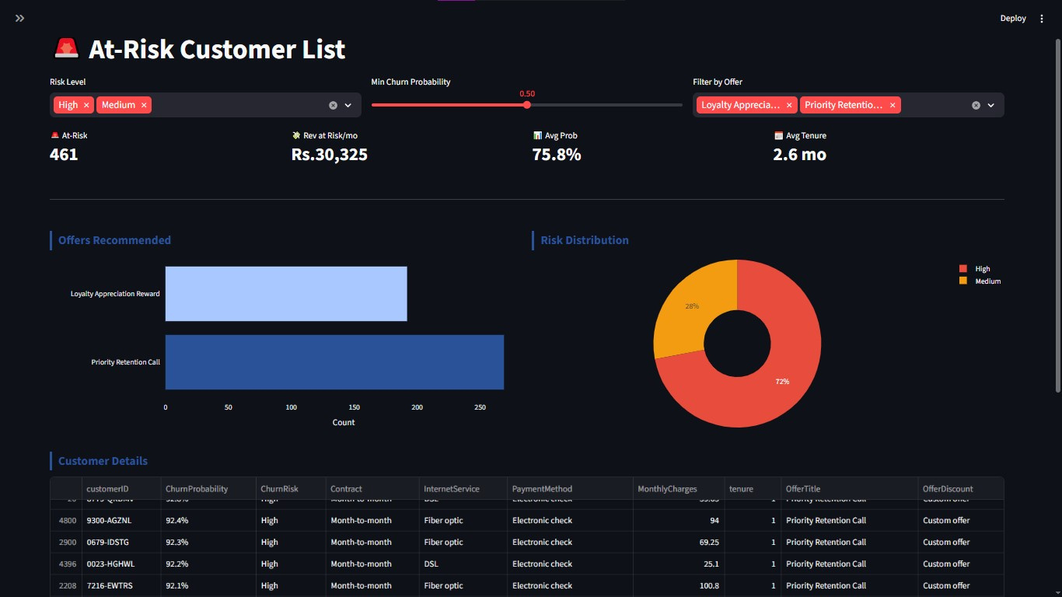
Screenshots & Reports
Comparison table (Accuracy, Precision, Recall, F1, ROC-AUC), confusion matrix heatmap, feature importance chart, ROC-AUC bar chart.
Filterable & sortable table: customerID, ChurnProbability, ChurnRisk, Contract, InternetService, MonthlyCharges, OfferTitle. CSV export.
Design and Implementation of a Scalable Telecom Customer Churn Prediction and Retention Platform
Notes:
12

Slide 13
Test Cases — Unit Test Plan (ETL Pipeline)
Test ID | Test Case | Input / Condition | Expected Result
TC-E01 | Validate columns — pass | All required columns present | No exception raised
TC-E02 | Validate columns — fail | Missing column | ValueError raised
TC-E03 | Dataset shape correct | Sample DataFrame | shape[1] == 21
TC-E04 | CustomerID unique | Sample DataFrame | Unique IDs only
TC-E05 | Dataset not empty | Loaded DataFrame | len(df) > 0
TC-C01 | TotalCharges numeric | Cleaned DataFrame | dtype == float64
TC-C02 | No null TotalCharges | Raw blank values | No nulls remain
TC-C03 | No duplicate rows | Cleaned DataFrame | 0 duplicates
TC-C04 | Strings stripped | Object columns | No extra spaces
TC-T01 | Churn binary encoded | Transformed DataFrame | Values in {0,1}
TC-T02 | Contract preserved after OHE | After encoding | Column exists
TC-T03 | InternetService preserved | After encoding | Column exists
TC-F01 | AnnualRevenue calculation | Featured DataFrame | Monthly × 12 correct
TC-F02 | LoyaltyScore range valid | Featured DataFrame | 0 ≤ score ≤ 1
Design and Implementation of a Scalable Telecom Customer Churn Prediction and Retention Platform
Notes:
13

Slide 14
Test Cases — ML, Prediction, Auth & Acceptance
Unit Tests — ML, Prediction & Auth
Acceptance Test Results
Test ID | Test Case | Expected Result
TC-P01 | Predict returns dictionary | Valid keys returned
TC-P02 | Probability range valid | 0.0 ≤ p ≤ 1.0
TC-R01 | High-risk contract offer | Offer assigned
TC-R02 | Retention call for very high-risk | RETENTION_CALL
TC-R03 | Offer fields present in output | Required fields exist
TC-A01 | Password hash verify — correct | Verification succeeds
TC-A02 | Wrong password fails | Verification fails
TC-A03 | Add/delete user flow | User added then removed
AT ID | Scenario | Result
AT-01 | Login with valid credentials | ✓ Pass
AT-02 | Wrong password — access denied | ✓ Pass
AT-03 | Run ETL — CSV generated | ✓ Pass
AT-04 | Dashboard KPIs displayed | ✓ Pass
AT-05 | High-risk prediction → offer | ✓ Pass
AT-06 | Filter high-risk users | ✓ Pass
AT-07 | CSV export download | ✓ Pass
AT-08 | Admin adds new user | ✓ Pass
AT-09 | Role restriction enforced | ✓ Pass
AT-10 | Access log timestamps | ✓ Pass
Design and Implementation of a Scalable Telecom Customer Churn Prediction and Retention Platform
Notes:
14

Slide 15
Test Results Summary
Test Class | Total Tests | Passed | Skipped | Failed
TestExtract | 5 | 5 | 0 | 0
TestCleaning | 6 | 6 | 0 | 0
TestTransform | 10 | 10 | 0 | 0
TestFeatureEngineering | 7 | 7 | 0 | 0
TestValidation | 3 | 3 | 0 | 0
TestPredict | 3 | 3 | 0 | 0
TestRecommend | 7 | 7 | 0 | 0
TestAuth | 4 | 4 | 0 | 0
TestConfig | 3 | 3 | 0 | 0
TOTAL | 48 | 48 | 0 | 0
🎯 100% Pass Rate — All 48 unit tests passed across 9 test classes
Design and Implementation of a Scalable Telecom Customer Churn Prediction and Retention Platform
Notes:
15

Slide 16
Limitations of the System
Dataset Scope: Uses IBM Telco sample (7,043 records) — may not fully represent all telecom segments, regional billing patterns, or enterprise-scale volumes.
Rule-Based Offers: Retention engine uses rule-based logic. Collaborative filtering or reinforcement learning would yield more granular, personalised recommendations.
Credential Storage: User credentials stored in a flat users.json file. A dedicated PostgreSQL users table would be more robust and auditable at enterprise scale.
No Real-Time Ingestion: Streamlit dashboard does not support real-time data. The ETL pipeline must be re-run manually to refresh customer scores and recommendations.
PySpark — Local Mode: PySpark currently runs in local mode. Distributed cluster deployment (AWS EMR, Databricks, or Azure HDInsight) is needed for true enterprise scalability.
No Notifications: No email or SMS notification when a customer crosses the high-risk threshold — limiting proactive retention team response.
Design and Implementation of a Scalable Telecom Customer Churn Prediction and Retention Platform
Notes:
16

Slide 17
Future Enhancements
01
02
03
04
Apache Airflow
Real-Time Kafka
Neural Networks
Cloud Deployment
Automate ETL scheduling using DAGs for daily/weekly data refresh
Apache Kafka for real-time event ingestion and immediate risk recalculation
TensorFlow/PyTorch and AutoML for improved prediction accuracy
AWS (S3+RDS+EC2) or Azure for production-grade availability
05
06
07
08
SHAP Explainability
FastAPI Layer
Power BI
Snowflake DWH
Human-readable explanations for each individual churn prediction
REST endpoints for CRM and billing system integration
Enterprise BI and executive reporting integration
Columnar analytical storage for seamless BI tool integration
Design and Implementation of a Scalable Telecom Customer Churn Prediction and Retention Platform
Notes:
17

Slide 18
Conclusion
This project successfully demonstrates the design and implementation of a complete, production-grade ETL pipeline for Telecom Customer Churn Analysis — integrating data engineering, machine learning, and business intelligence into a unified deployable platform built entirely on open-source technologies.
ETL Pipeline: End-to-end processing of 7,043 customer records
ML Pipeline: 3 models trained; best auto-selected by ROC-AUC; batch scoring applied
Risk Classification: 3-tier churn risk (High/Medium/Low) for all customers
Retention Engine: 7-strategy personalised offer recommendation engine
Dashboard: 5-page Streamlit dashboard with role-based access control
Authentication: PBKDF2-SHA256 auth with complete audit logging
PySpark: Enterprise-scale distributed processing demonstrated
Test Suite: 100% pass rate — 48 unit tests across 9 test classes
Design and Implementation of a Scalable Telecom Customer Churn Prediction and Retention Platform
Notes:
18

Slide 19
References / Bibliography
[1] IBM Sample Datasets. (2024). Telco Customer Churn Dataset. Kaggle. https://www.kaggle.com/blastchar/telco-customer-churn
[2] Apache Software Foundation. (2024). PySpark API Documentation — Apache Spark 3.5. https://spark.apache.org/docs/latest/api/python/
[3] Streamlit Inc. (2024). Streamlit Documentation. https://docs.streamlit.io
[4] scikit-learn Developers. (2024). scikit-learn: Machine Learning in Python. JMLR, 12, 2825–2830.
[5] McKinney, W. (2022). Python for Data Analysis (3rd ed.). O'Reilly Media.
[6] SQLAlchemy Authors. (2024). SQLAlchemy Documentation. https://docs.sqlalchemy.org
[7] PostgreSQL Global Development Group. (2024). PostgreSQL 15 Documentation. https://www.postgresql.org/docs/15/
[8] Chen, T., and Guestrin, C. (2016). XGBoost: A Scalable Tree Boosting System. KDD 2016, 785–794.
[9] Plotly Technologies Inc. (2024). Plotly Python Open-Source Graphing Library. https://plotly.com/python/
[10] pytest Development Team. (2024). pytest Documentation. https://docs.pytest.org
[11] Kleppmann, M. (2017). Designing Data-Intensive Applications. O'Reilly Media.
[12] Provost, F., and Fawcett, T. (2013). Data Science for Business. O'Reilly Media.
Design and Implementation of a Scalable Telecom Customer Churn Prediction and Retention Platform
Notes:
19

Slide 20
Annexure — Sample Code
extract.py — Data Extraction
auth.py — Password Hashing (PBKDF2-SHA256)
def extract_data(filepath):
if not os.path.exists(filepath):
raise FileNotFoundError(...)
df = pd.read_csv(filepath)
validate_columns(df, REQUIRED_COLUMNS)
shutil.copy2(filepath, BACKUP_DATA)
return df
def _hash_password(password):
salt = os.urandom(32).hex()
key = hashlib.pbkdf2_hmac(
"sha256", password.encode(),
salt.encode(), 260_000)
return f"{salt}:{key.hex()}"
train_model.py — ML Training
recommend.py — Retention Offer Engine
models = {
"RandomForest": RandomForestClassifier(
n_estimators=200,
class_weight="balanced"),
"GradientBoosting": GradientBoostingClassifier(
n_estimators=150,
learning_rate=0.08),
}
for name, model in models.items():
auc = roc_auc_score(y_test, model...)
if auc > best_auc: best_model = model
def recommend_offer(row):
prob = row["ChurnProbability"]
if prob >= 0.80:
return OFFERS["RETENTION_CALL"]
if row["SeniorCitizen"] == 1:
return OFFERS["SENIOR_PLAN"]
if "Month-to-month" in row["Contract"]:
return OFFERS["CONTRACT_UPGRADE"]
return OFFERS["STANDARD_LOYALTY"]
Design and Implementation of a Scalable Telecom Customer Churn Prediction and Retention Platform
Notes:
20

Slide 21
Thank you!!!
PRESENTED BY
Divyesh S. Joshi
Seat No.: 52419 | Roll No.: MC24097
Design and Implementation of a Scalable Telecom Customer Churn Prediction and Retention Platform
Design and Implementation of a Scalable Telecom Customer Churn Prediction and Retention Platform
Notes:
1

